Slide 1


Care After COVID
Track 2.01
Notes:
Our product “Care After Covid” is designed for Covid Long haulers like myself. My name is Amy.

Slide 2

Track 2.01
Amy’s Story
Young adult
Mild case of COVID in July 2020
Shortness of breath and heart palpitations
Not confident in the care she is currently receiving
Feeling frustrated
Notes:
Covid long haulers are defined by the CDC as anyone suffering from symptoms 4 weeks after symptom onset. Being one of 1.7 million covid long haulers in the United States, I suffered from a myriad of symptoms, saw countless specialists and felt frustrated and alone, getting no real answers.

Slide 3
Track 2.01
Problem Statement
There are unclear pathways for communicating symptoms over time and accessing care for COVID long haulers (medical desert), creating a sense of disempowerment. This increases the probability of costly readmissions and specialist visits.
Notes:
Our problem statement is..
There are unclear pathways for communicating symptoms over time and accessing care for COVID long haulers (them being our medical desert), creating a sense of disempowerment. This increases the probability of costly readmissions and specialist visits.

Slide 4
Track 2.01
Long-haulers’ extra care could result in increased health insurance premiums for more than
If 20% of Americans contract novel coronavirus, one year post hospitalization costs would be more than
Up to
Estimated
10%
1.7M
Of people who’ve had COVID experience prolonged symptoms in the weeks after an infection
people in the United States have “long COVID”
50%
Of Americans
$50
BILLION
with private health plans
John Hopkins
Kaiser Family Foundation
New York Public School of Health
British Medical Journal
Notes:
The estimated costs of Covid care in general is significant, affecting our economy for years to come, and inefficient care for long haulers like the care that I received earlier on in this pandemic only adds to that exorbitant price tag.

Slide 5
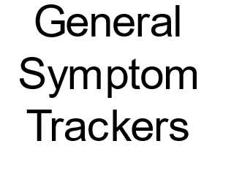
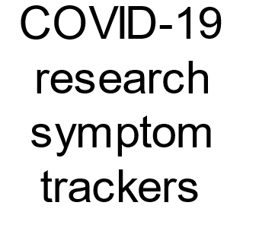
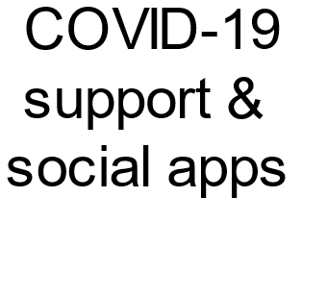



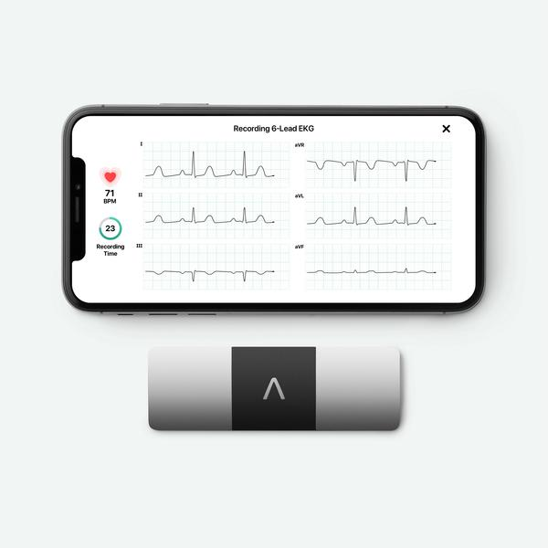

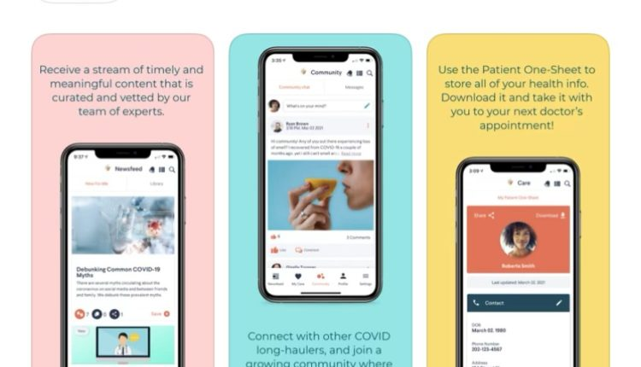



Track 2.01
Existing Solutions
ACCESSIBLE
LONGITUDINAL
PERSONALIZED
ACTIONABLE
Notes:
Our solution "Care After COVID" addresses the market gap, specifically meeting the needs of our population.

Slide 6
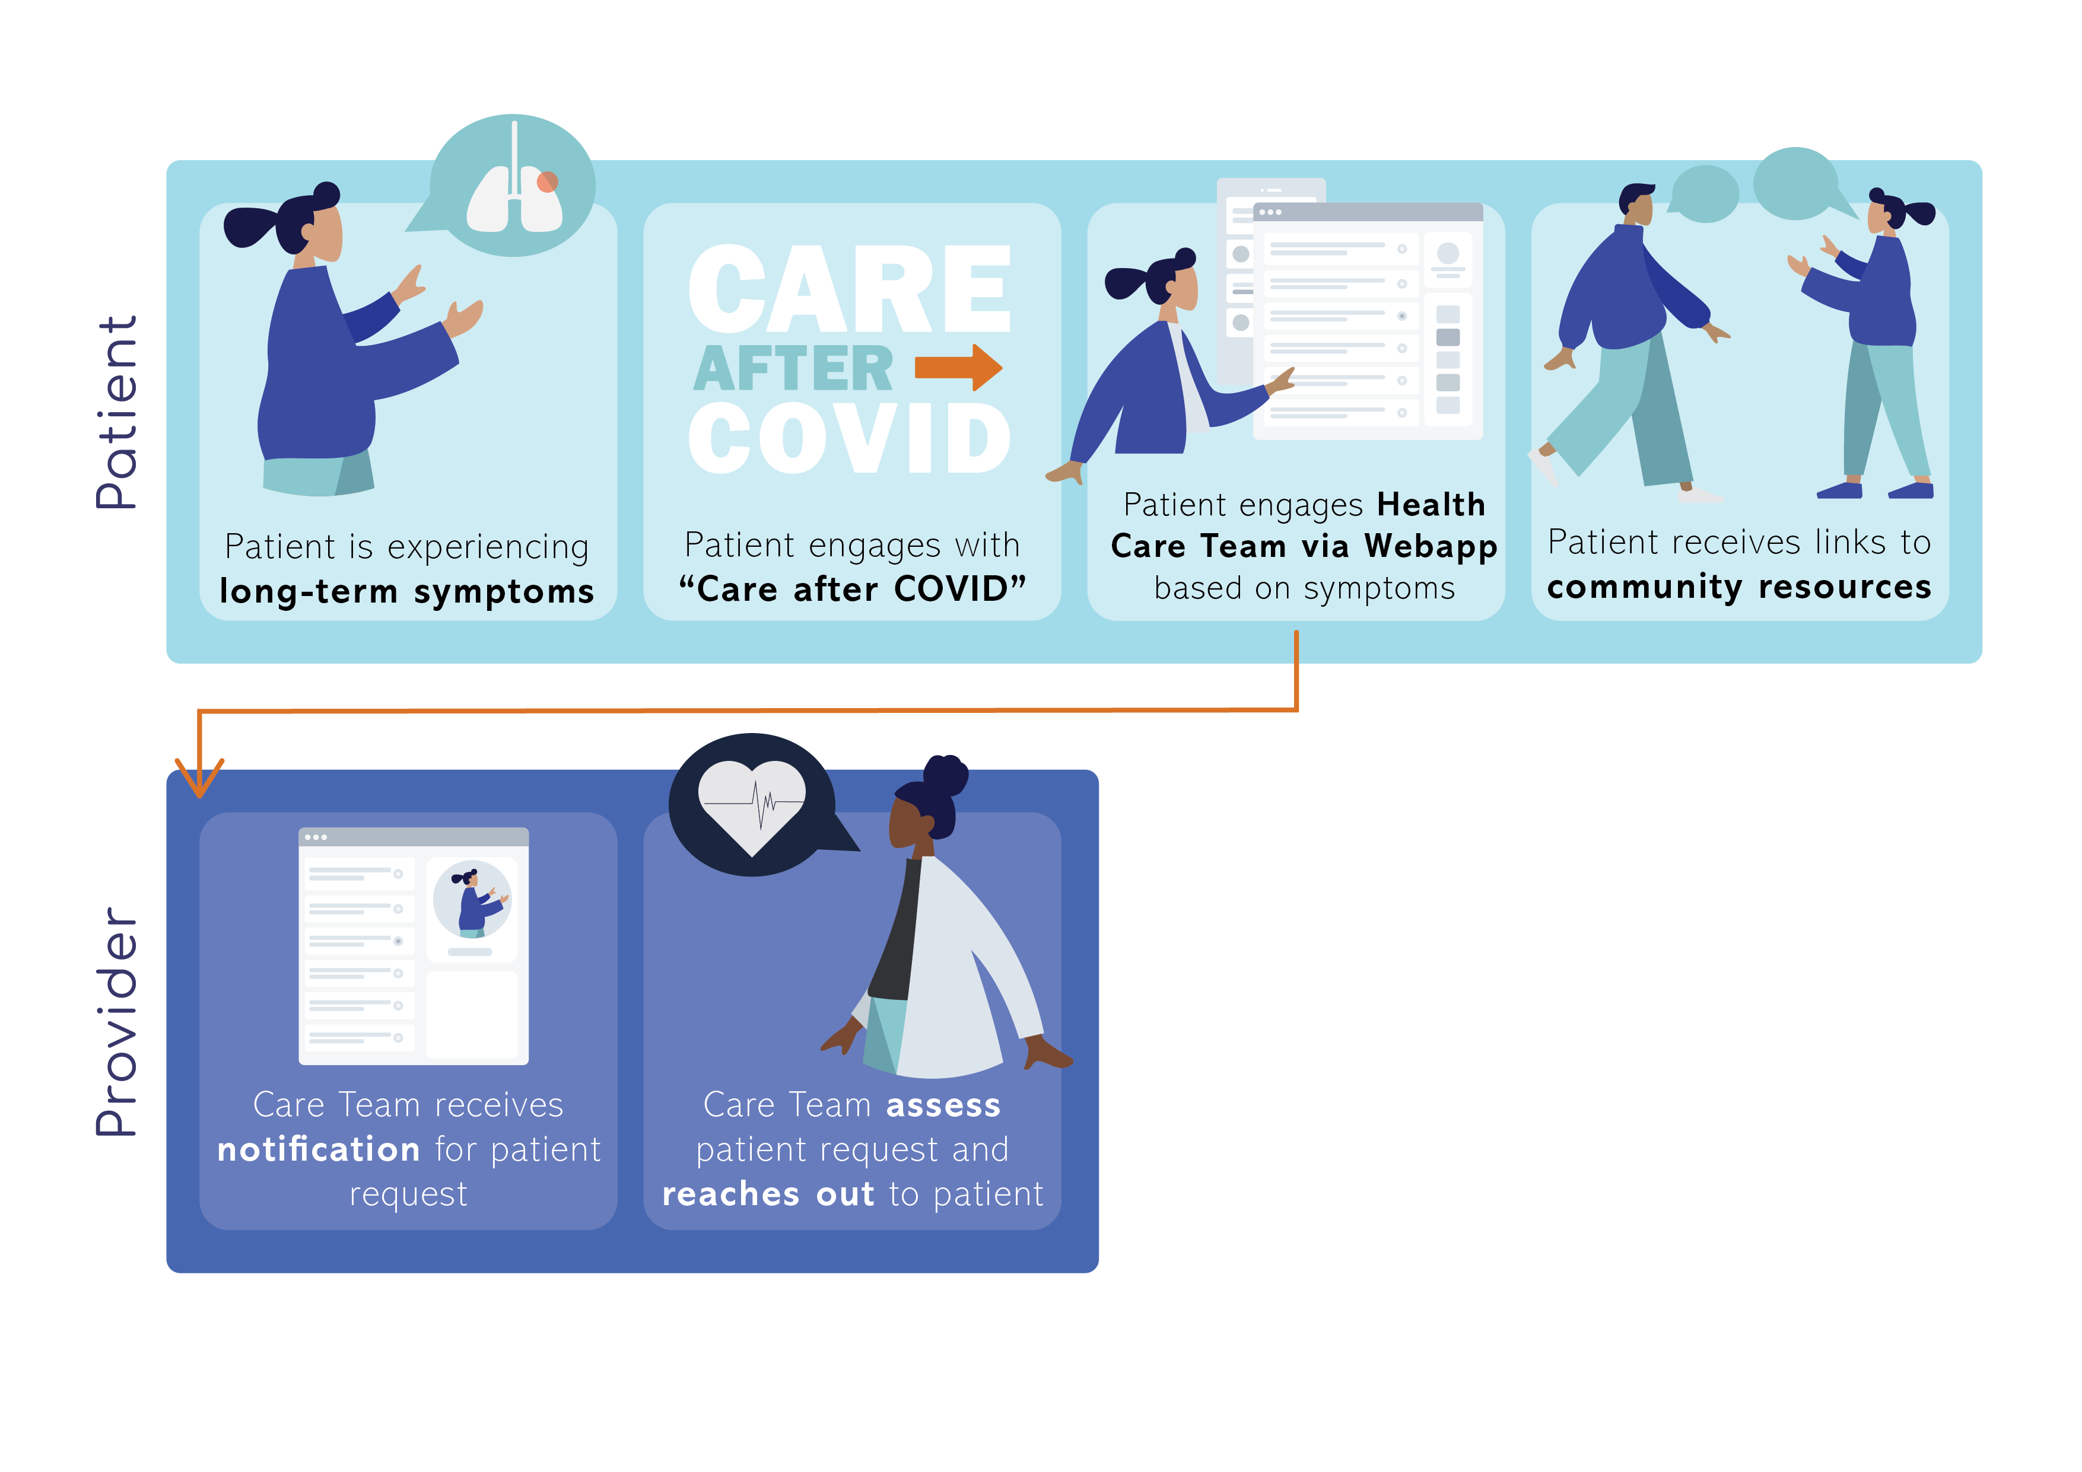
Track 2.01
User Flow
Notes:
Our solution" Care After COVID" is a web based application that will allow the patient to connect with a care team, and multiple support resources

Slide 7
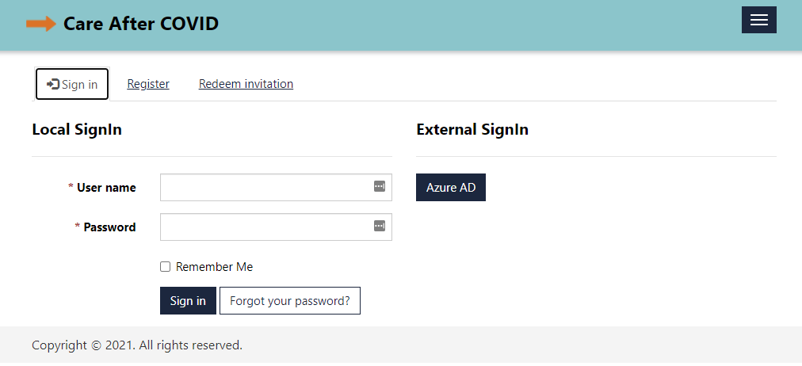
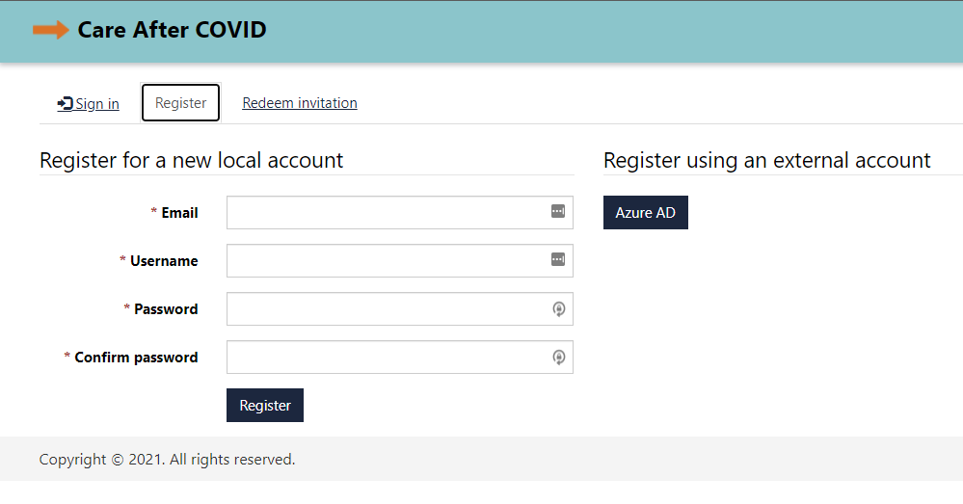
Notes:
This is our product entry point, where the patient can register.

Slide 8
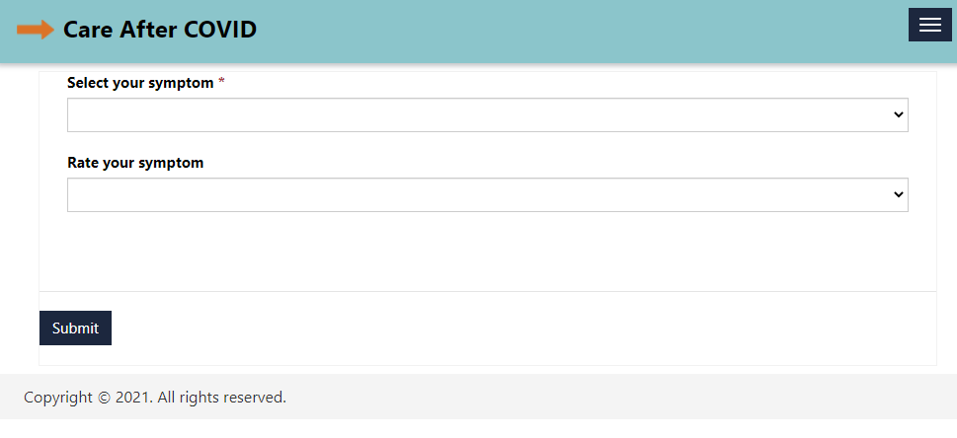
Notes:
This is where the patient would enter and rate the severity of symptoms.

Slide 9
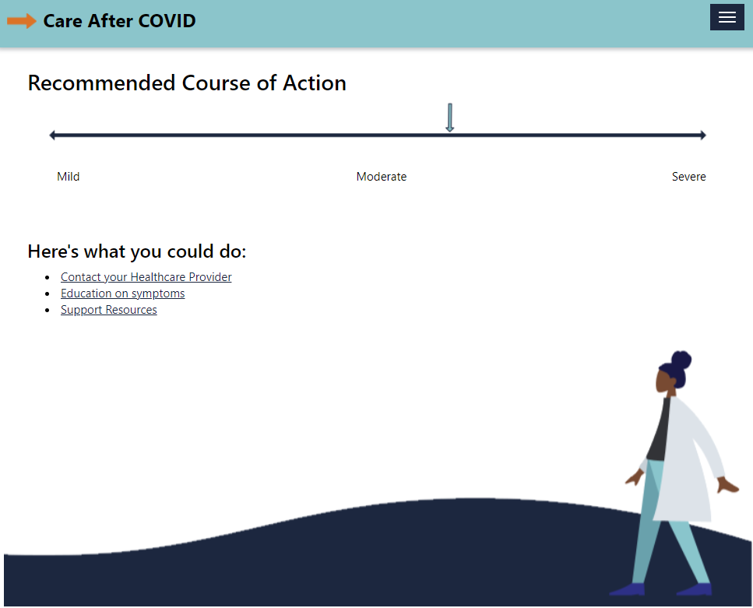
Notes:
This screen will lead the patient to a call of action, where they can choose to connect with Healthcare providers or access education on symptoms and support resources

Slide 10
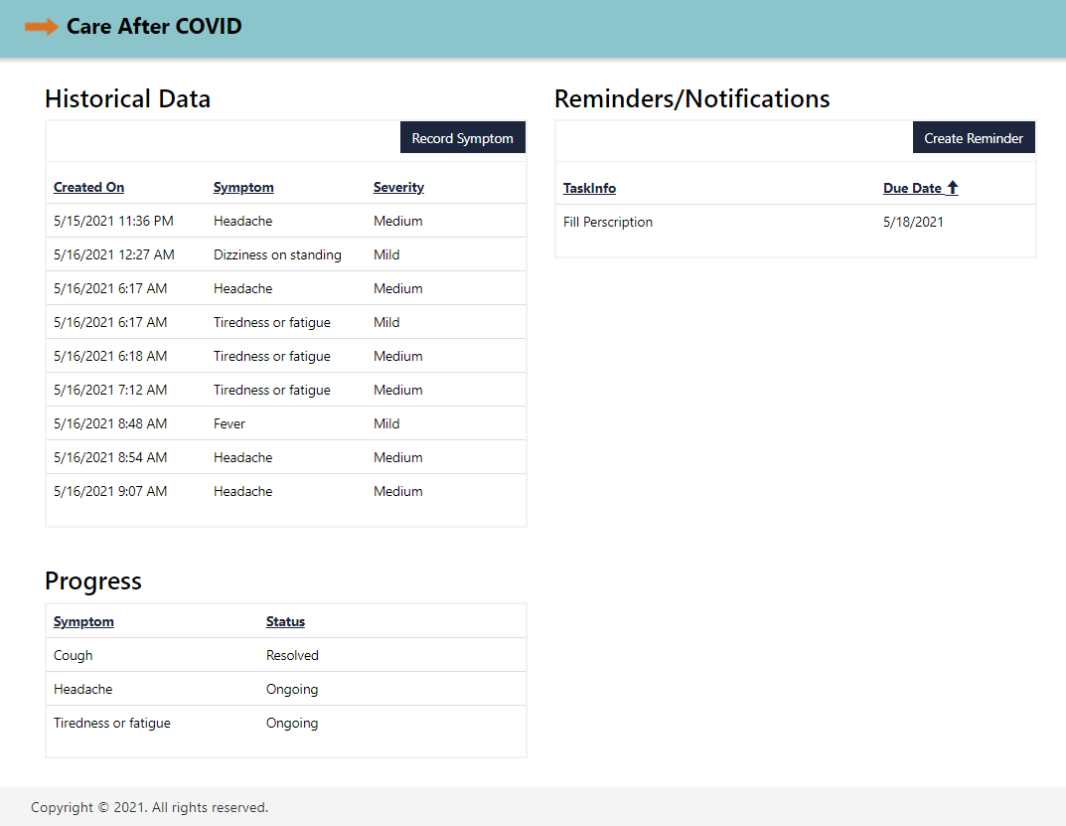
Notes:
Over time, the patient would track their symptoms that a clinician could access to help inform patient care.

Slide 11

Track 2.01
Business Plan
Partners/Consumers
Covid Long Haul Patients
Covid Long Haul Rehabilitation Clinics
Funding
Grant Funding – Long Term Covid
NIH: ( 1.15 billion over years) Tracking recovery/Investigation of Long Term Covid
Pitch events, accelerators for start-ups
Primary Care Providers
Regional Health Care Systems
Public Health Care Systems
Notes:
These are our targeted partners and consumers and our identified source of funding.

Slide 12

Track 2.01
Launch of MVP in one COVID-19 clinic (pilot)
Outcomes and UX/UI evaluation (product iteration)
Integration with EHRs (seamless coordination)
Aggregate data dashboard (useful for patients and providers)
Expansion to all COVID clinics (national scaling)
Scalability
Notes:
Recently, a small number of Covid clinics have been popping up worldwide.
Our future outlook for the expansion of our product, to help long haulers, like Amy, is to share data between these partners, consumers and patients and truly provide “Care after Covid”.

Slide 13
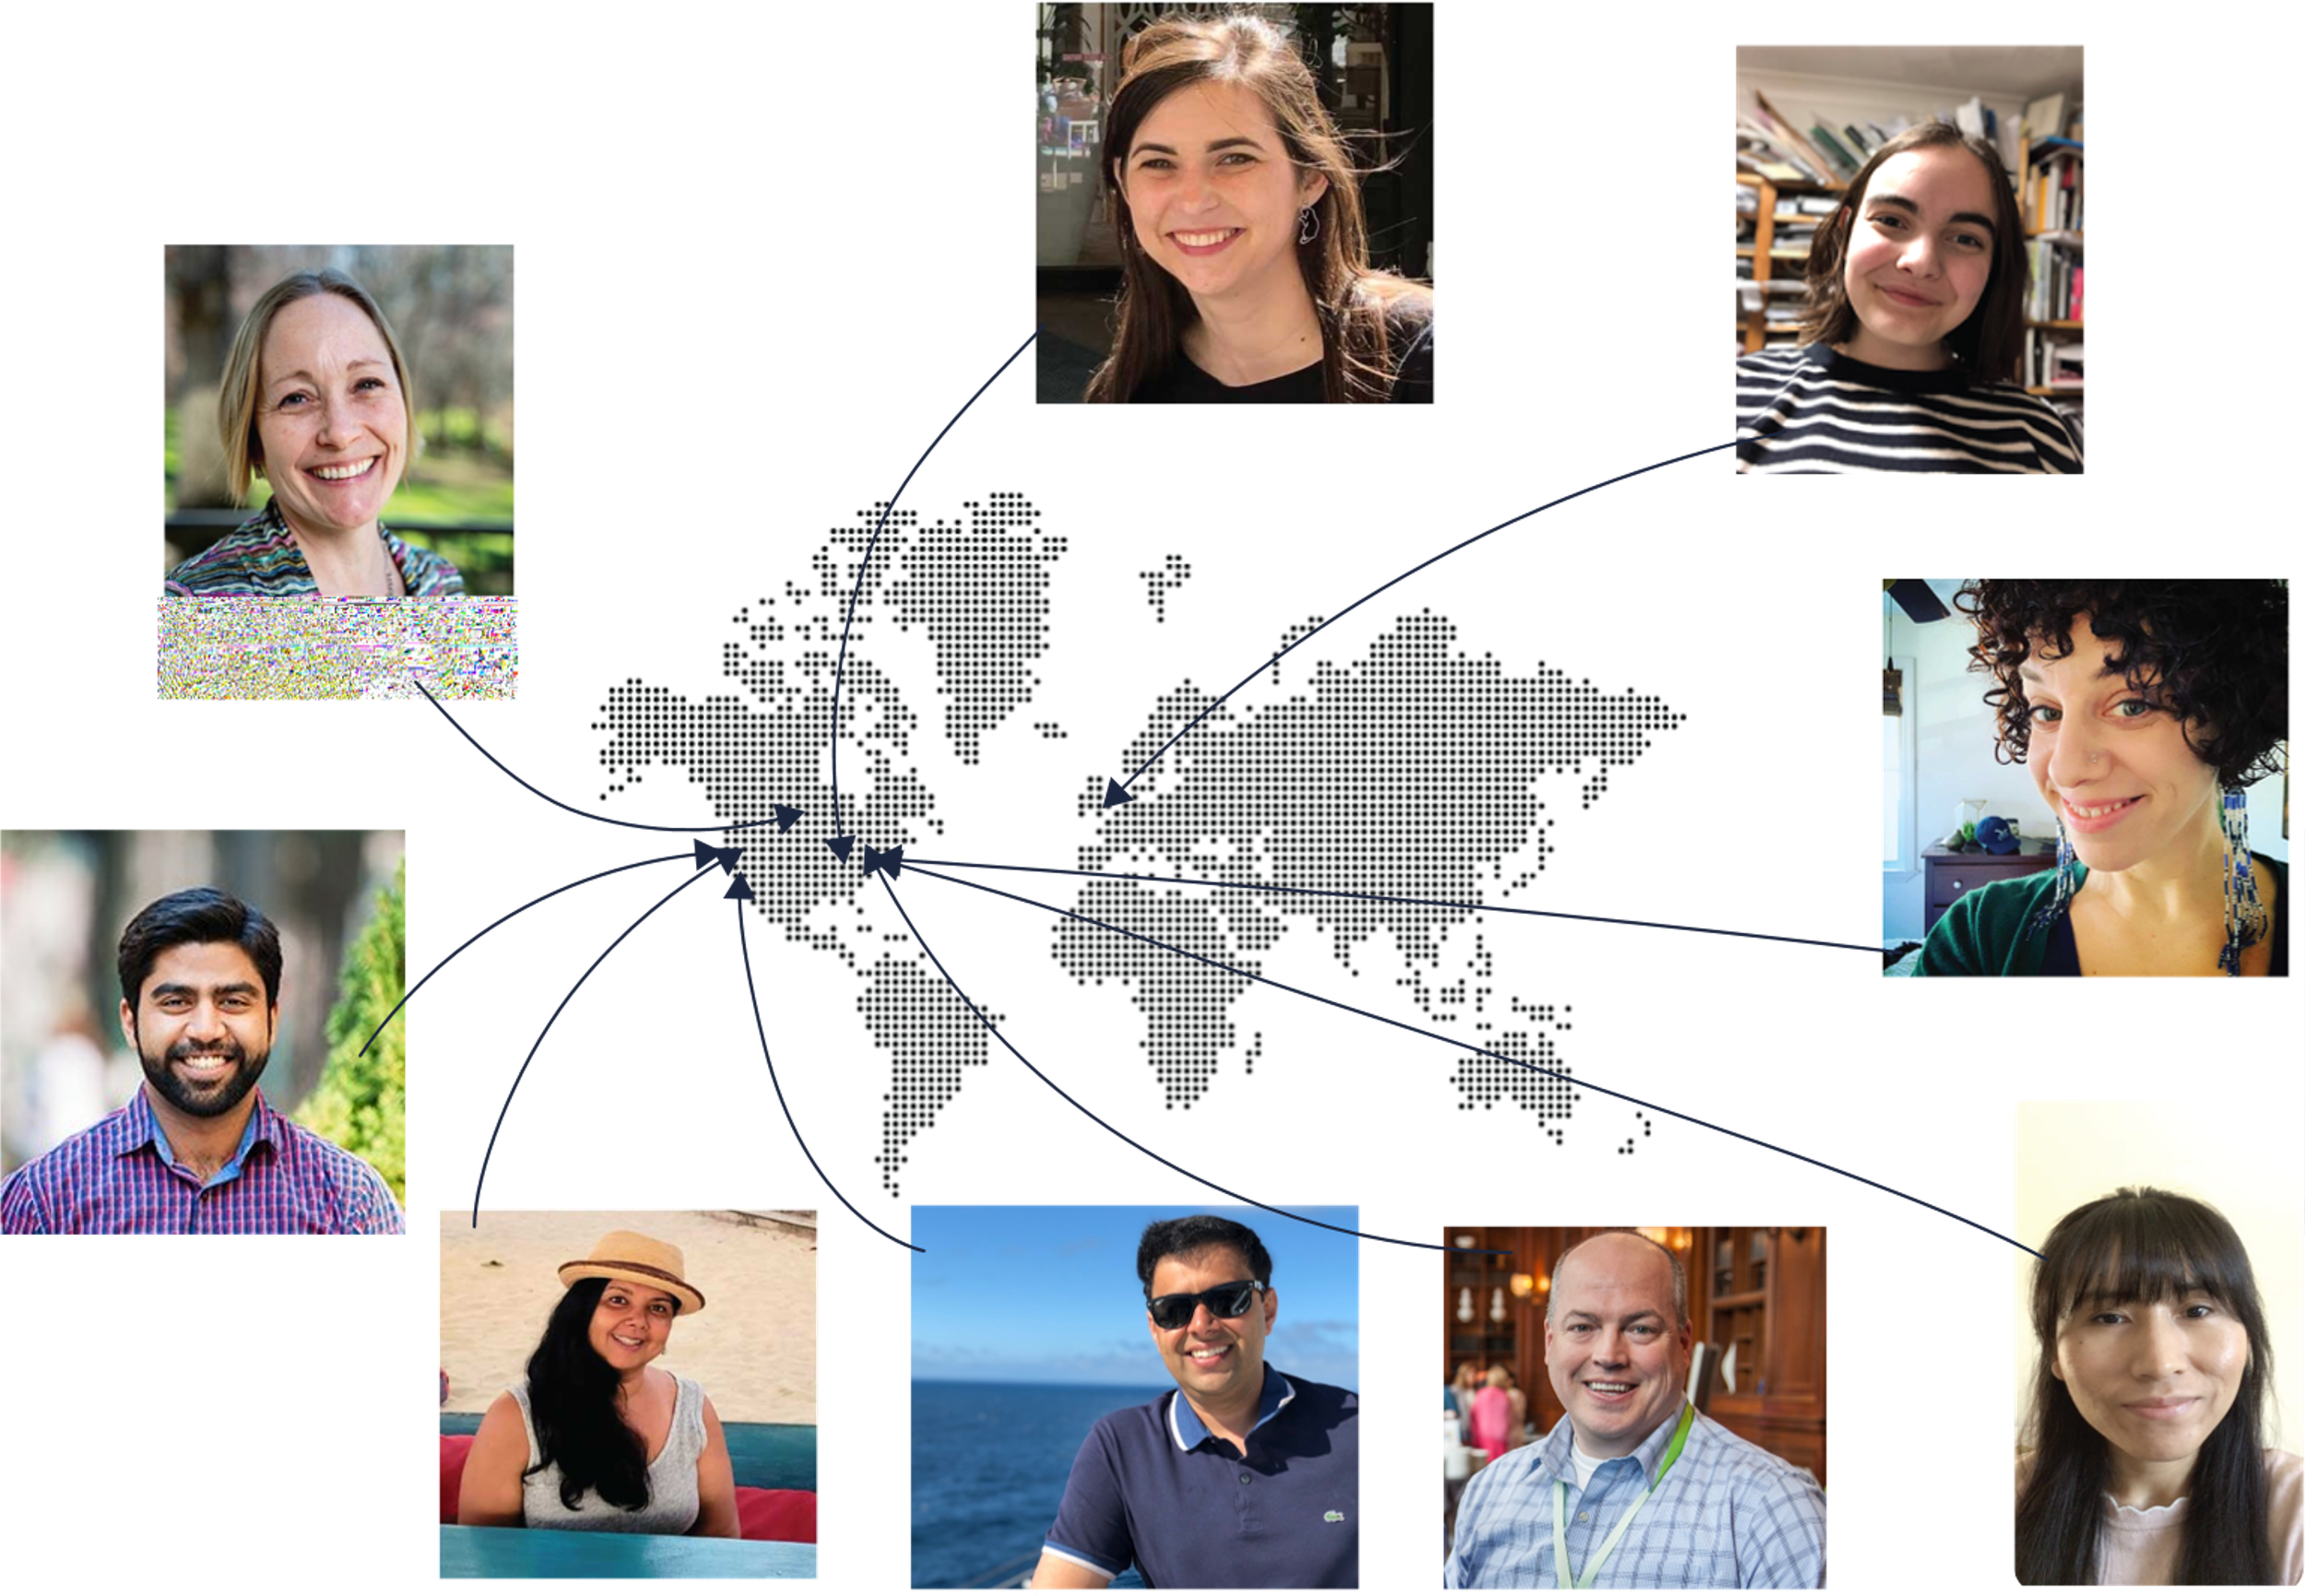
Track 2.01
Our Team
With acknowledgements to Leslie Hill and coaches
Jane Evered, PhD RN
Silke Heyse
Deidra Heuring DNP RN
Amy Salomone MAT
Vasu Sharma
Vaishali Wells RN MBA
Kunal Jain
Rich Ross
Tenzin Nelung, NP-C, RN
Notes:
This is our team

Slide 14

Track 2.01
Access
Connection
Knowledge
Notes:
We are Care after Covid!

Slide 15

Track 2.01
Ensuring Access
Medical care
Trustworthy
information
Social support
Connecting Patients
Support resources
Care team
Generating Knowledge
Data collection & aggregation
Notes:
Our solution is a web based application that will allow the patient to connect with a care team, and multiple support resources
This application will also allow for data collection and aggregation to inform the clinical practice, helping the provider keep closer connection with covid long haulers.

Slide 16

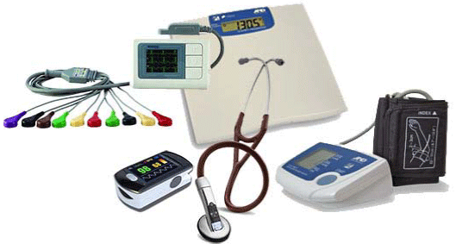
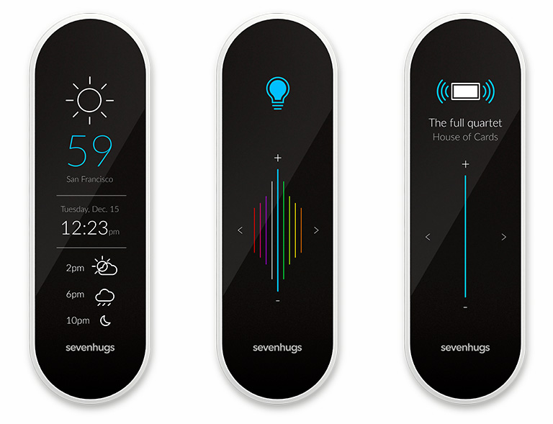
Current solutions in the market
Notes:
KEY POINT: There are many examples of remote monitoring and symptom tracking apps, but relatively little available specific to long haulers and their unique symptom and care accessing experiences. To address the problem of long COVID we need an accessible, actionable, longitudinal, and personalized system.

Slide 17
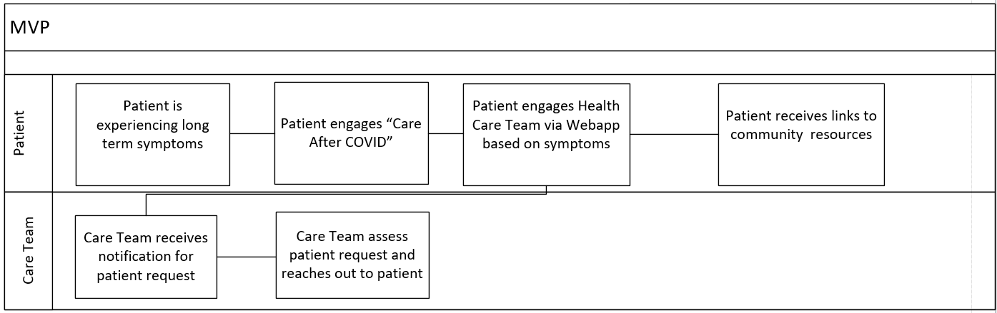
Track 2.01
User Flow
Notes:
You can see what our product experience would look like for the patient and healthcare provider.

Slide 18
Data
John Hopkins | Estimated 1.7M people in the United States have “long COVID”
Kaiser Family Foundation | Long-haulers' extra care costs could result in increased health insurance premiums for more than 50% of Americans with private health plans. 2021 (premiums up 8% due to Covid)
American Health Insurance Plan (AHIP) | Cost $30-$547 Billion dollars over a 2yr period
New York Public School of Health | If 20% of Americans contract novel coronavirus, one year post hospitalization costs would be more than $50 billion
British Medical Journal. | Up to 10% of people who've had COVID experience prolonged symptoms in the weeks after an infection.

